Slide 1




Empowering Canadians in the Gig economy

Slide 2
Problem

Slide 3



Market Trends: Rise of the Gig Economy
13M
63% workers enjoy freelancing because of work freedom
Of the Canadian workforce by 2020
average weekly hours increasing to 1 billion hr/week

Slide 4



Freelancer Challenges
Getting started
Managing finances
Network Building

Slide 5
Solution

Slide 6
Learning
Community
Financing
Fantastic 6 is a community-based financing platform for Canadian freelancers

Slide 7
How It Works
She borrows $1000
She needs to repay $172 per month for the next 6 months because her credit score is 690
He lends her $1000
He gets back $170 per month for the next 6 months.
He makes $30 in interest all while giving back to the gig economy
Notes:
Age 23
Waitress by day
Freelance photographer on the side but needs money for new equipment

Slide 8
How We Make Money
YEAR 1: target 2,000 users who borrow/lend up to $5,000,
1% service fee
we generate $100,000 revenue
Notes:
Age 23
Waitress by day
Freelance photographer on the side but needs money for new equipment

Slide 9
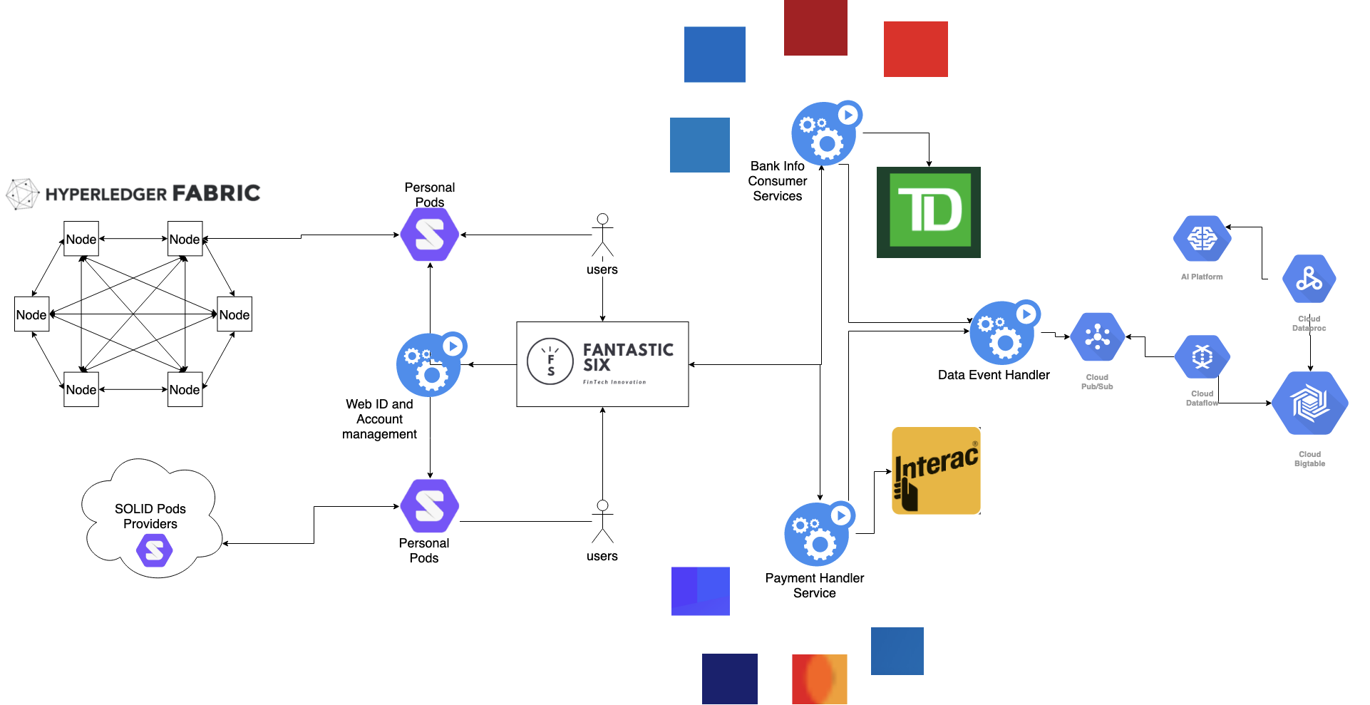
Technical Advantage

Slide 10

Product Demo: Press Play

Slide 11
Competitive Advantage
Why Freelancer choose us?
Why investors choose us?
Get Financing up to $5,000
Get community support
Access to learning platform
Opportunity to invest in gig economy
Secured and reliable borrowers
Earn returns on investment
Notes:
Mention competitiors

Slide 12

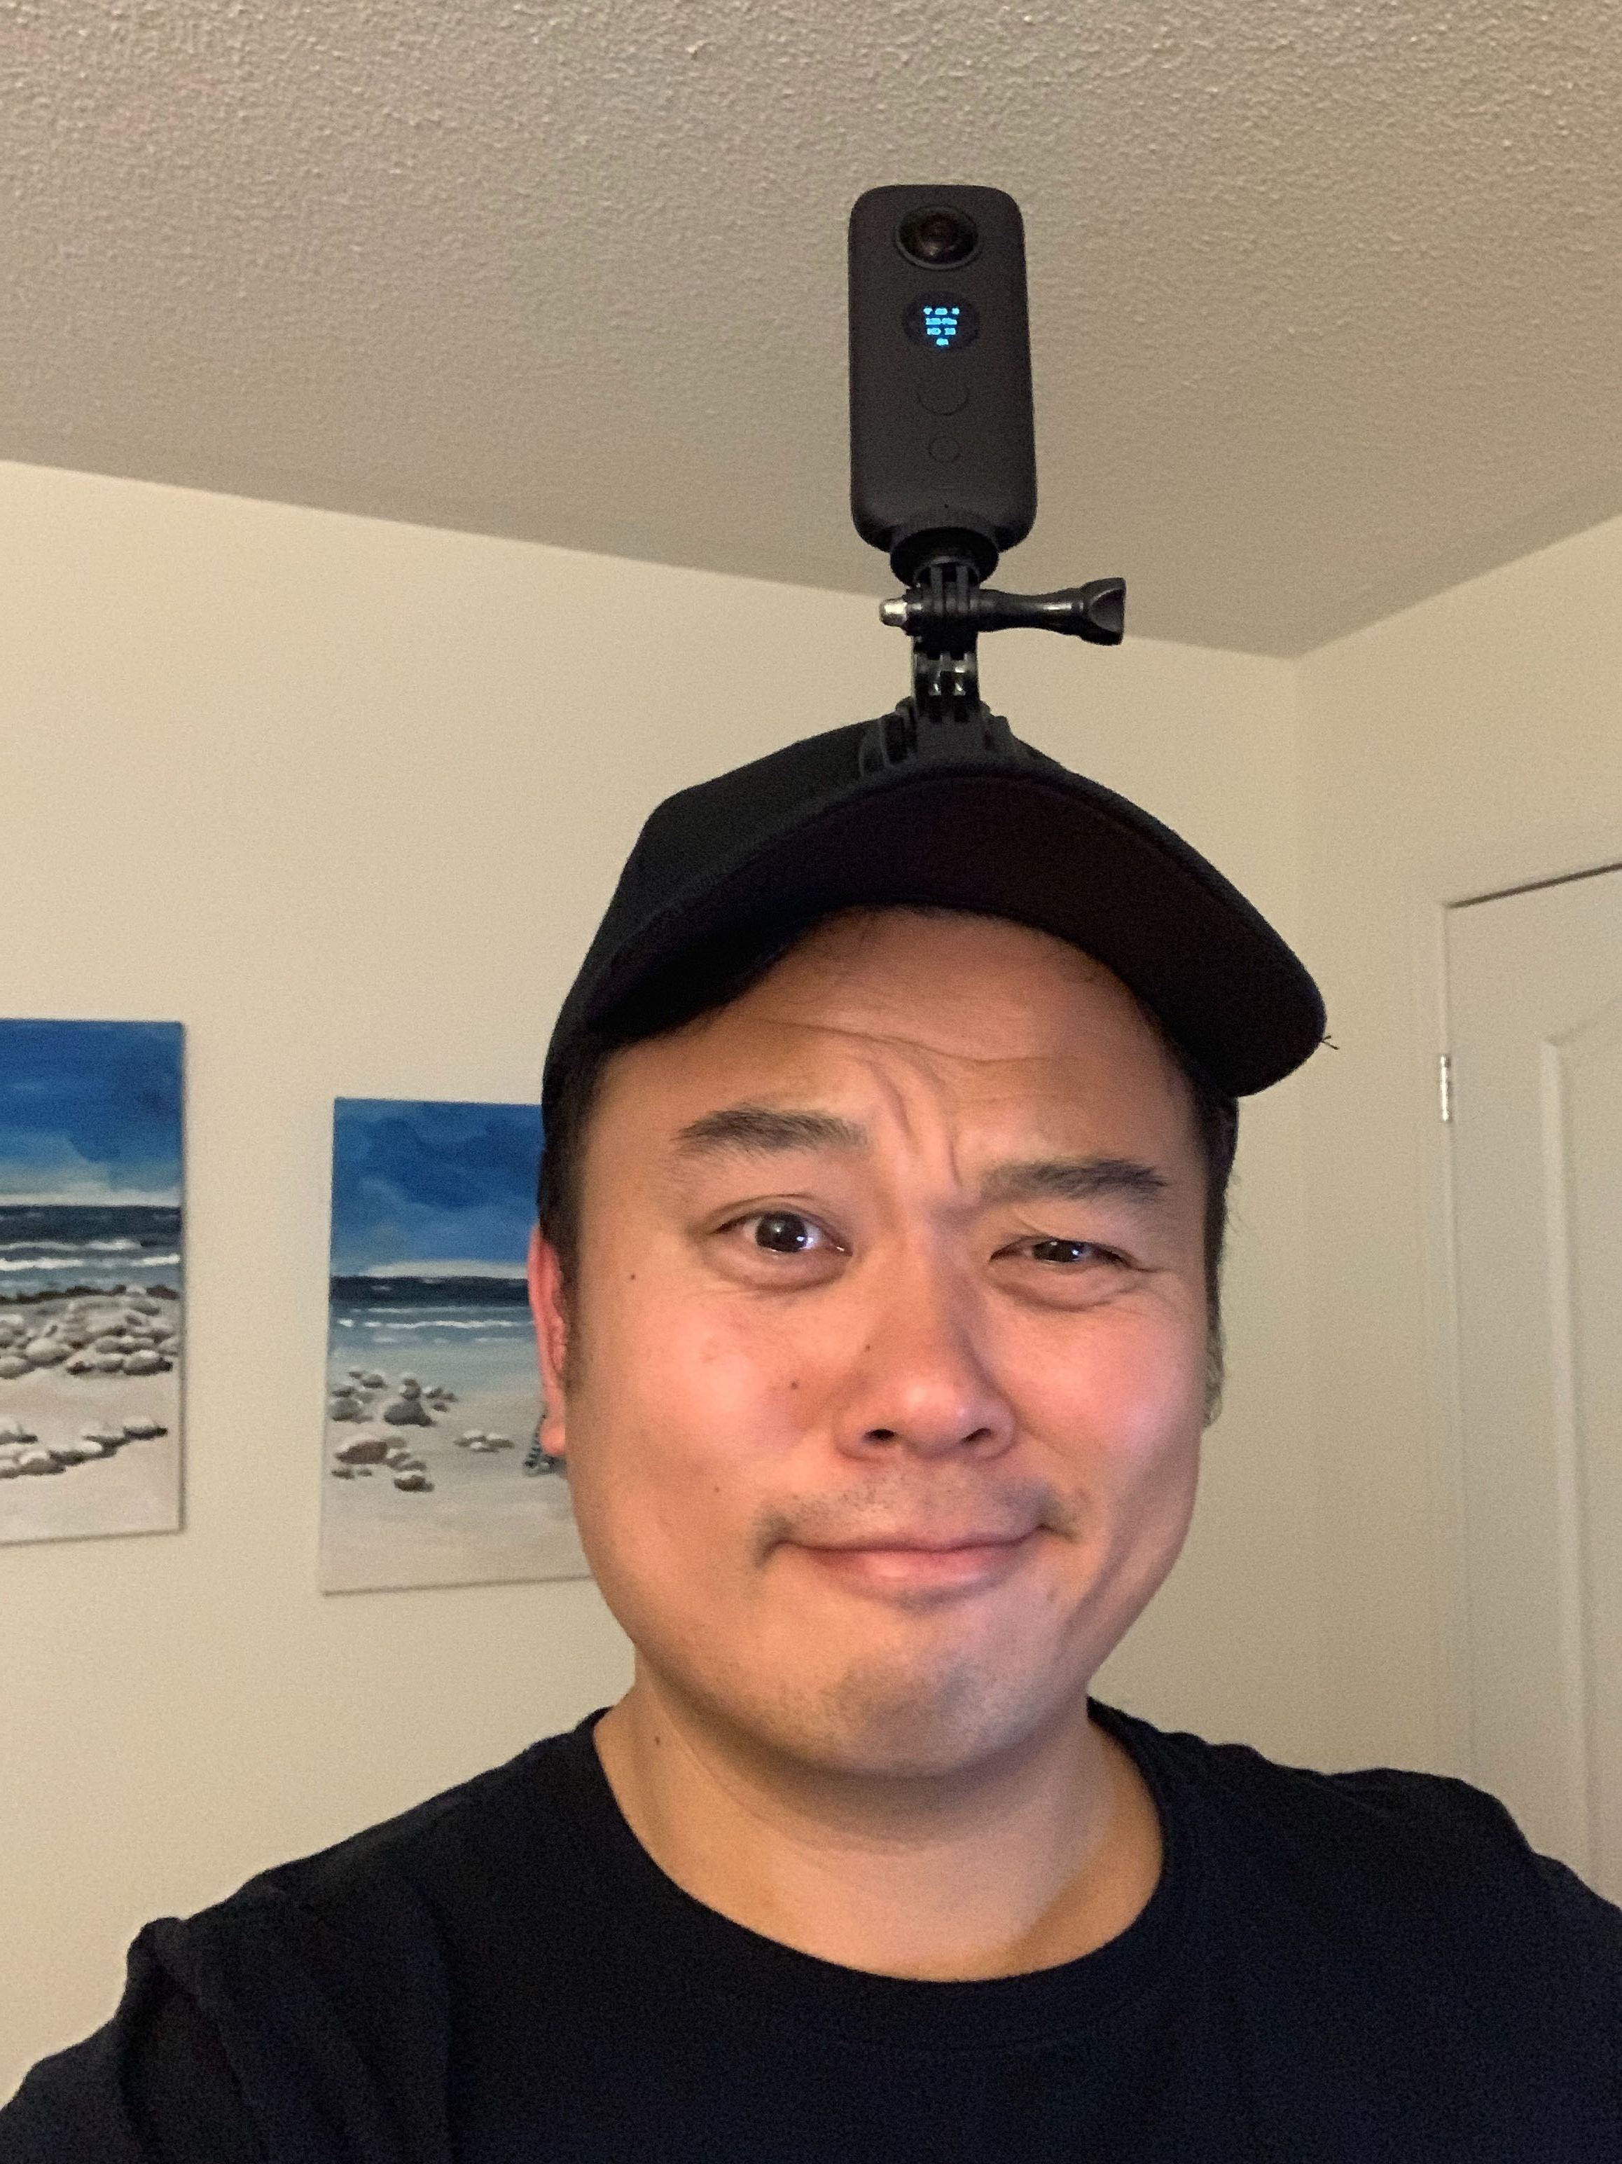


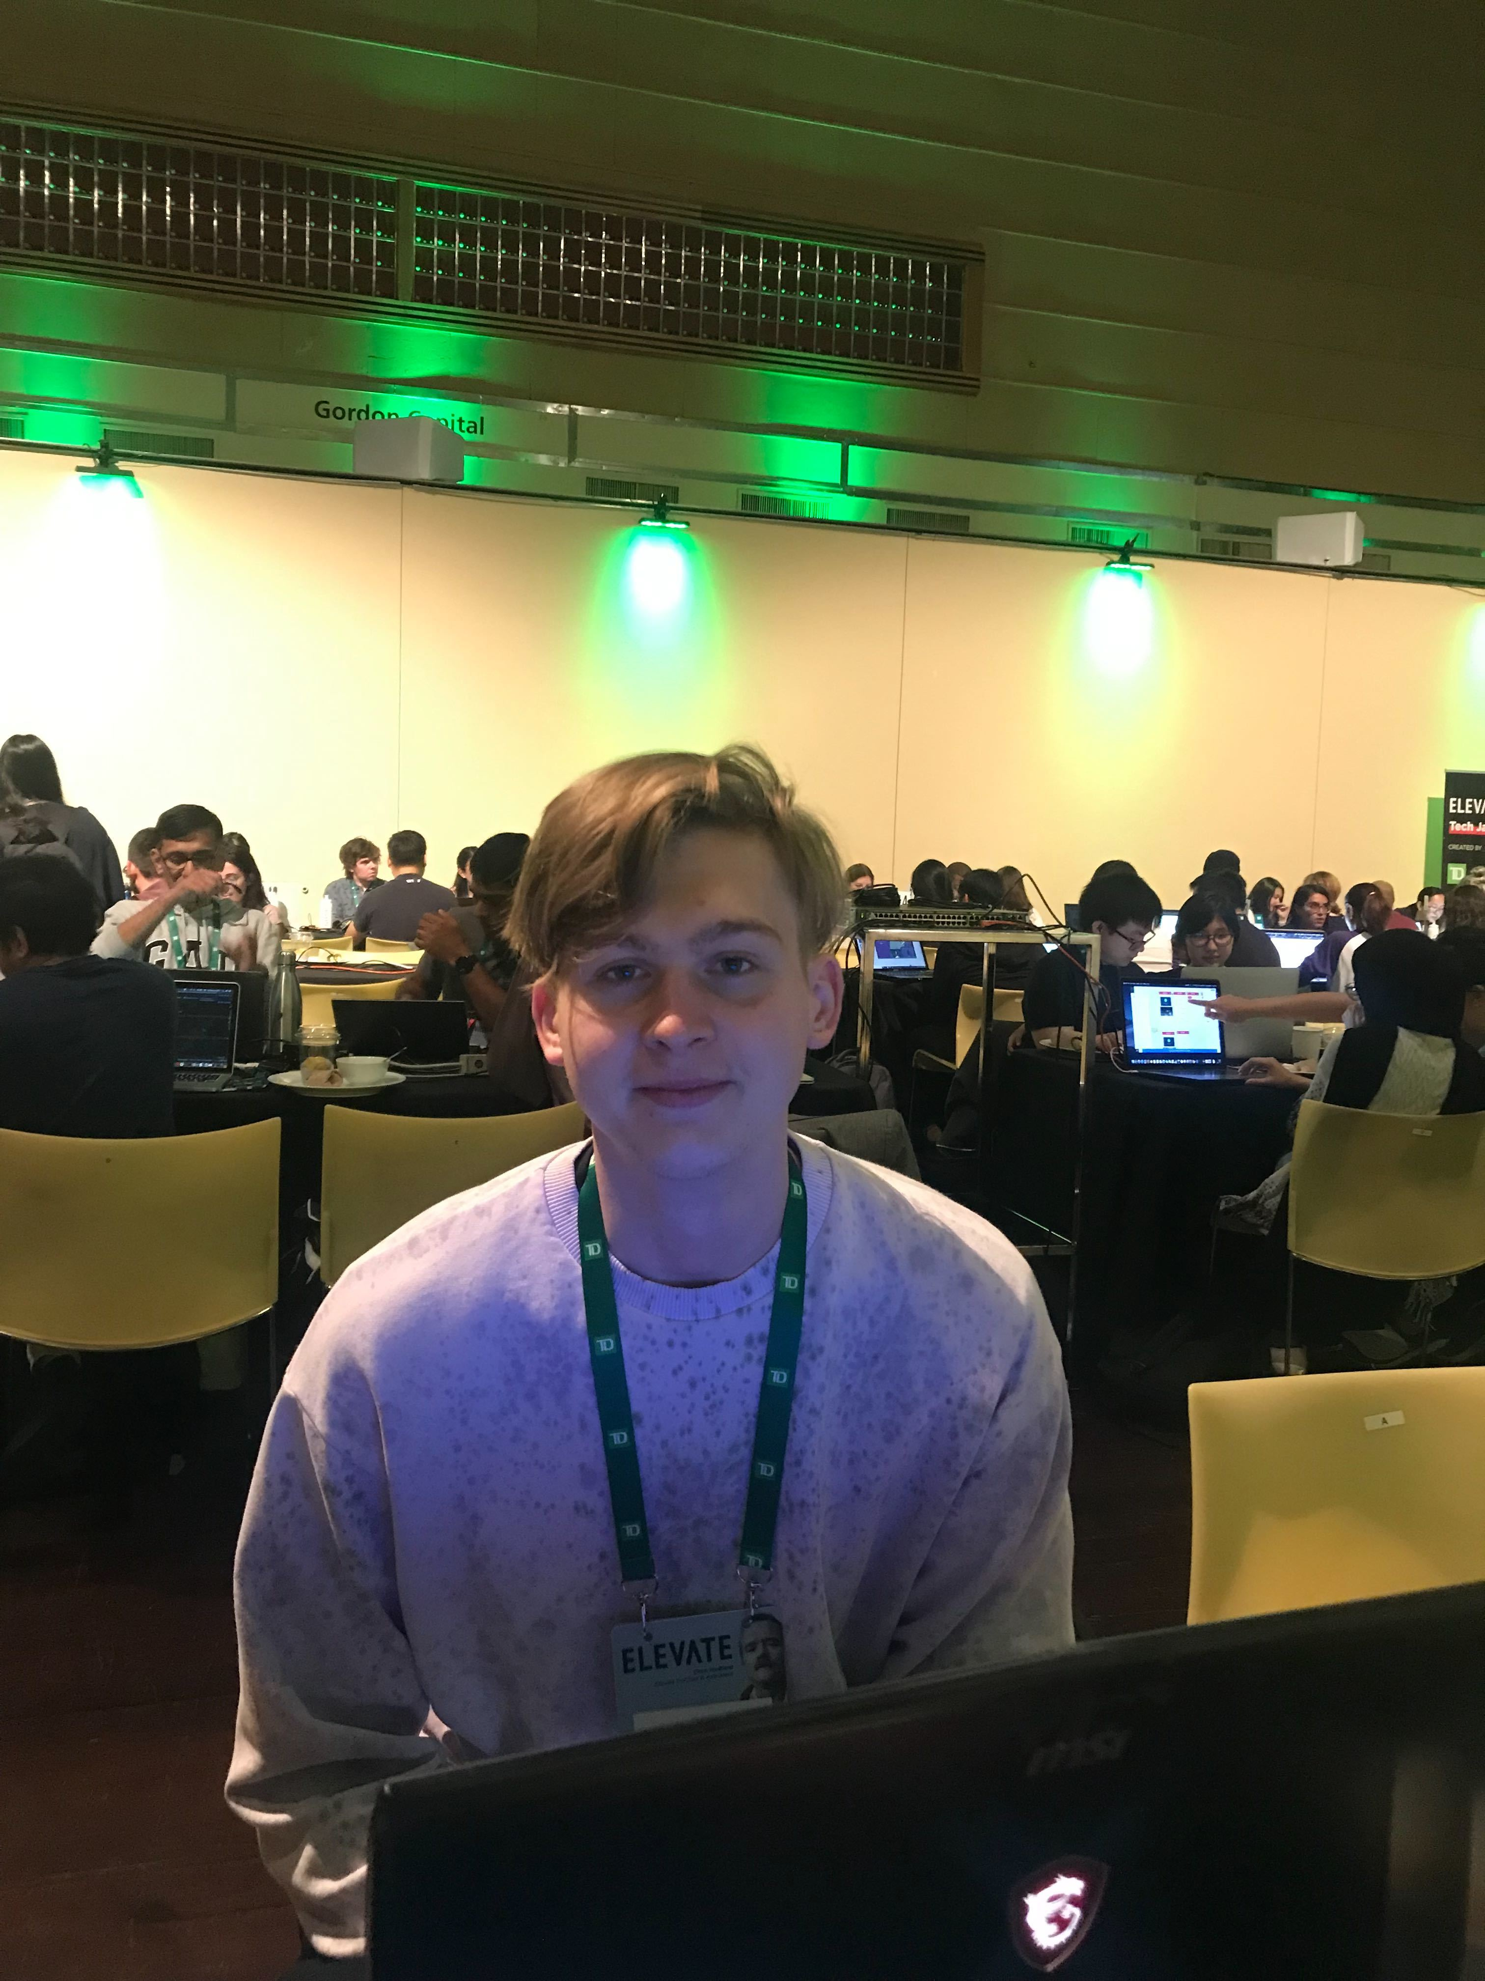

Meet The Team
Tiffany
Kris
Alina
Baba
Janet
Viktor
Notes:
Please fix photos to fit in circles!

Slide 13
Thank You

